Slide 1
PREDICTING ALUMNI GIVING RATE

Slide 2
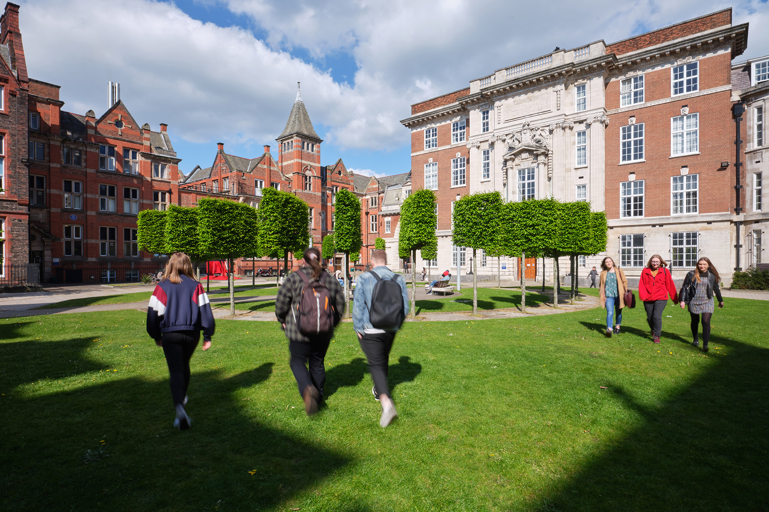
Session Agenda
Topic
Goal
Response variable and Predictors
Exploring data
Correlation
Multiple Linear Regression Model
Comparing Models
Fixing the final model

Slide 3
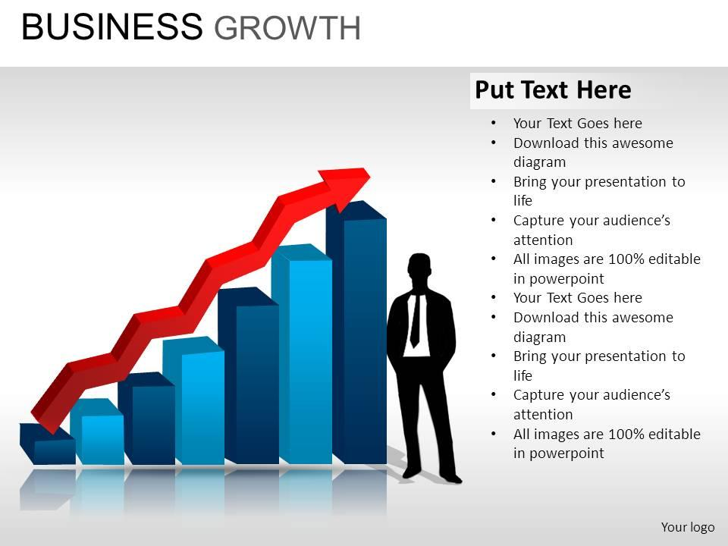
Goal, Data and Method
Topic
Topic
Alumni Giving - To investigate the factors influencing alumni donation.
Goal
Goal
Predict the alumni giving rate using the
independent variables.
Show the impact of the above variables on the
alumni donation rate.

Slide 4
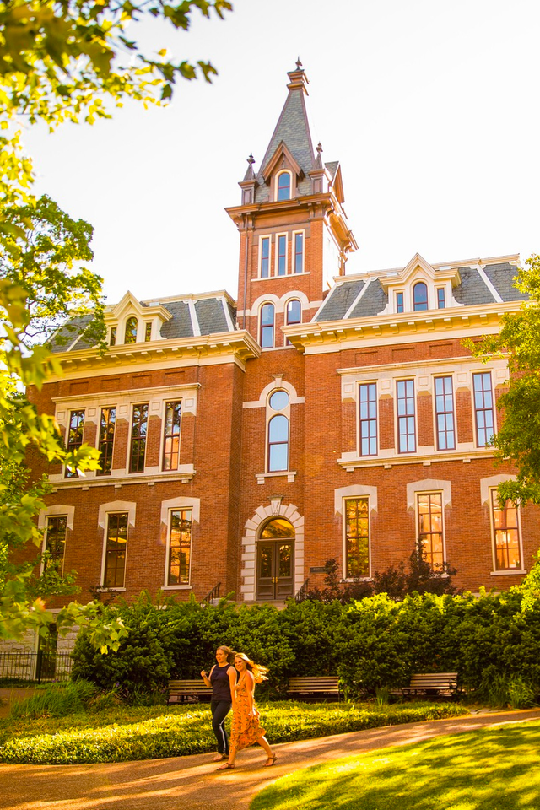
Variables
Response Variable
Predictors
Alumni Giving Rate – Percentage of alumni who
donated to the university.
Predictors
Graduation Rate
% of Classes Under 20
Student-Faculty Ratio

Slide 5
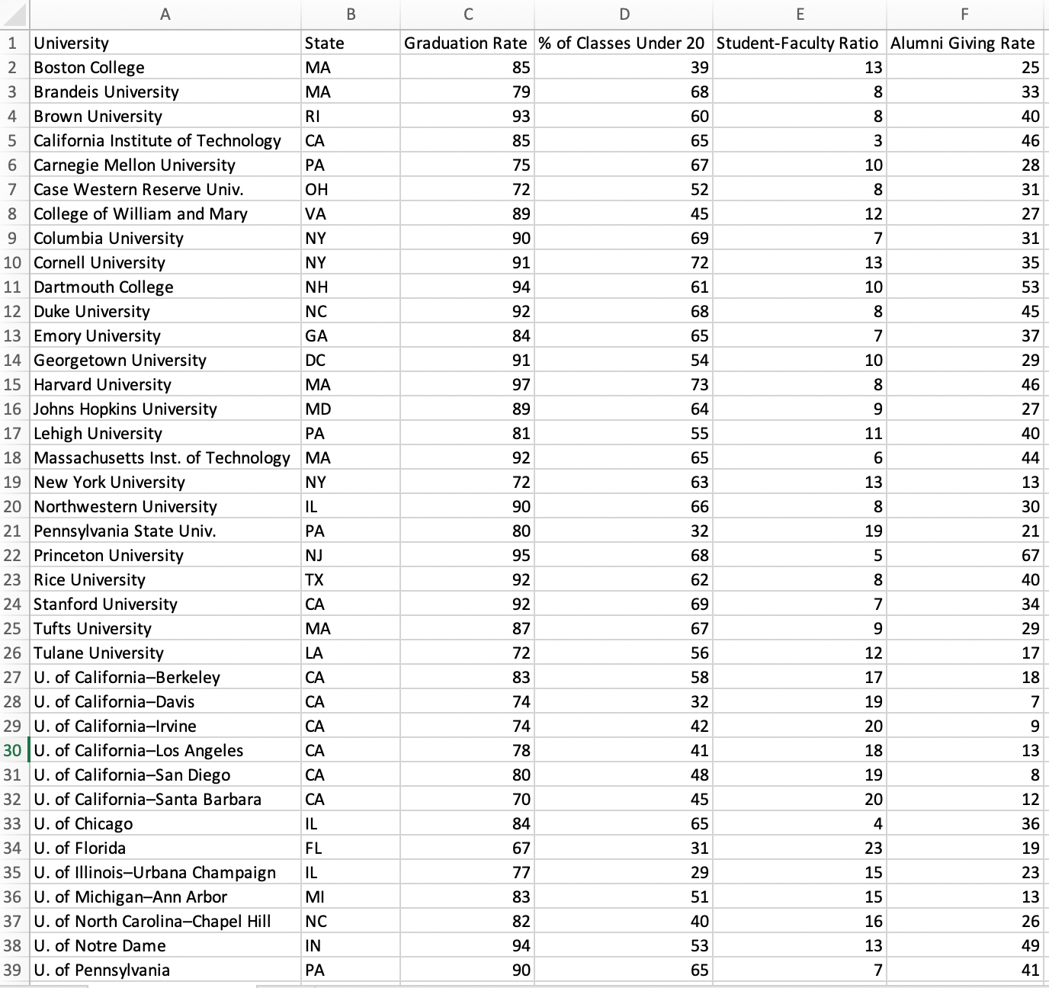
Dataset

Slide 6
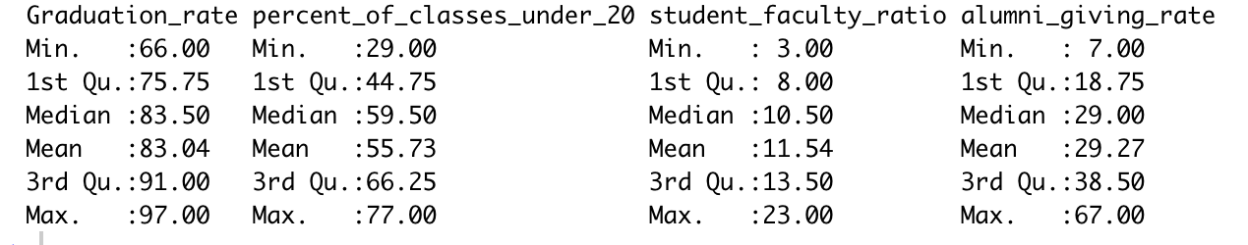
Data summary
Summary of all the variables
Alumni giving rate can vary from 7% to 67%

Slide 7
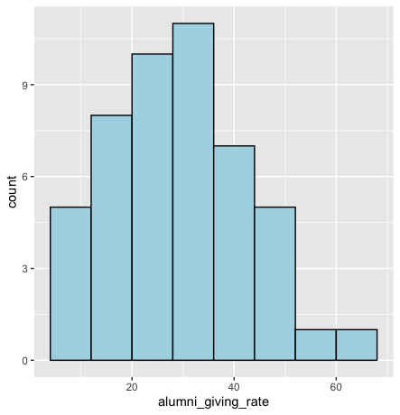
Exploring data
Slightly right skewed

Slide 8
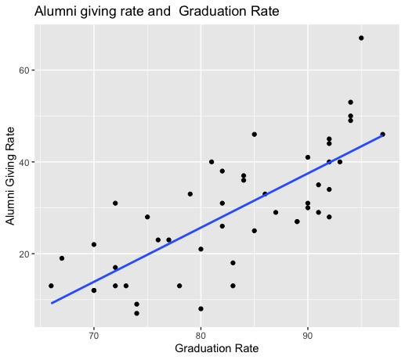
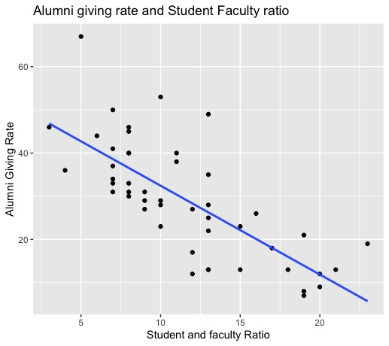
Exploring data

Slide 9
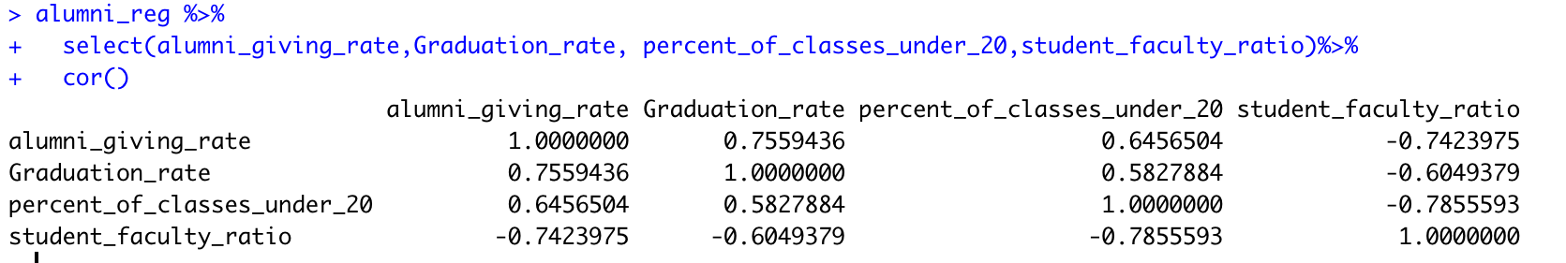
Correlation
Positive relationship between graduation rate and Alumni giving rate
Negative relation with student faculty ratio

Slide 10
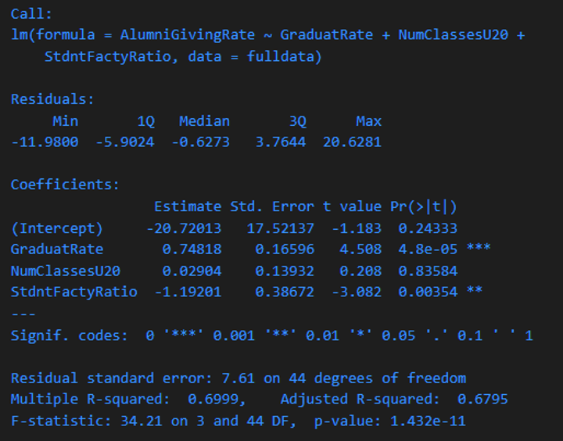
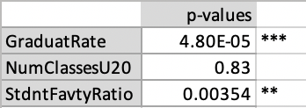
MODEL 1:
The independent variable “% of Classes Under 20” is removed from the model.

Slide 11
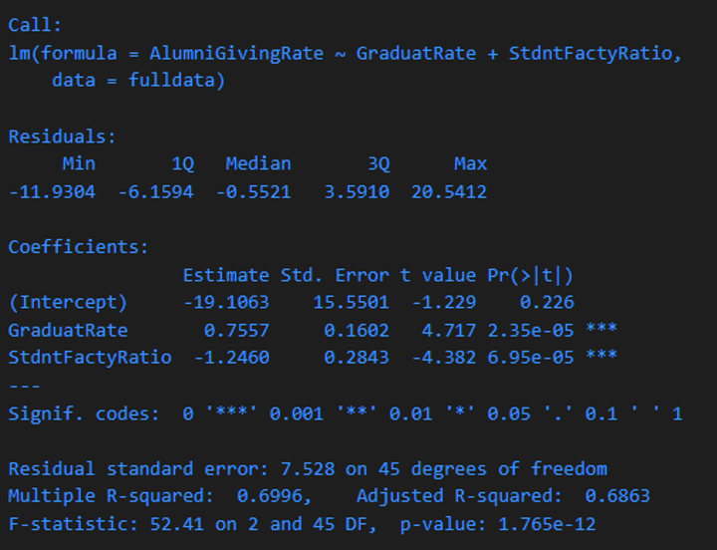
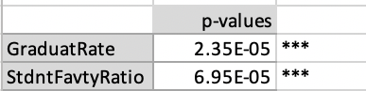
MODEL 2
The regression equation is Y = 0.7557 x1 - 1.2460 x2 – 19.1063.

Slide 12
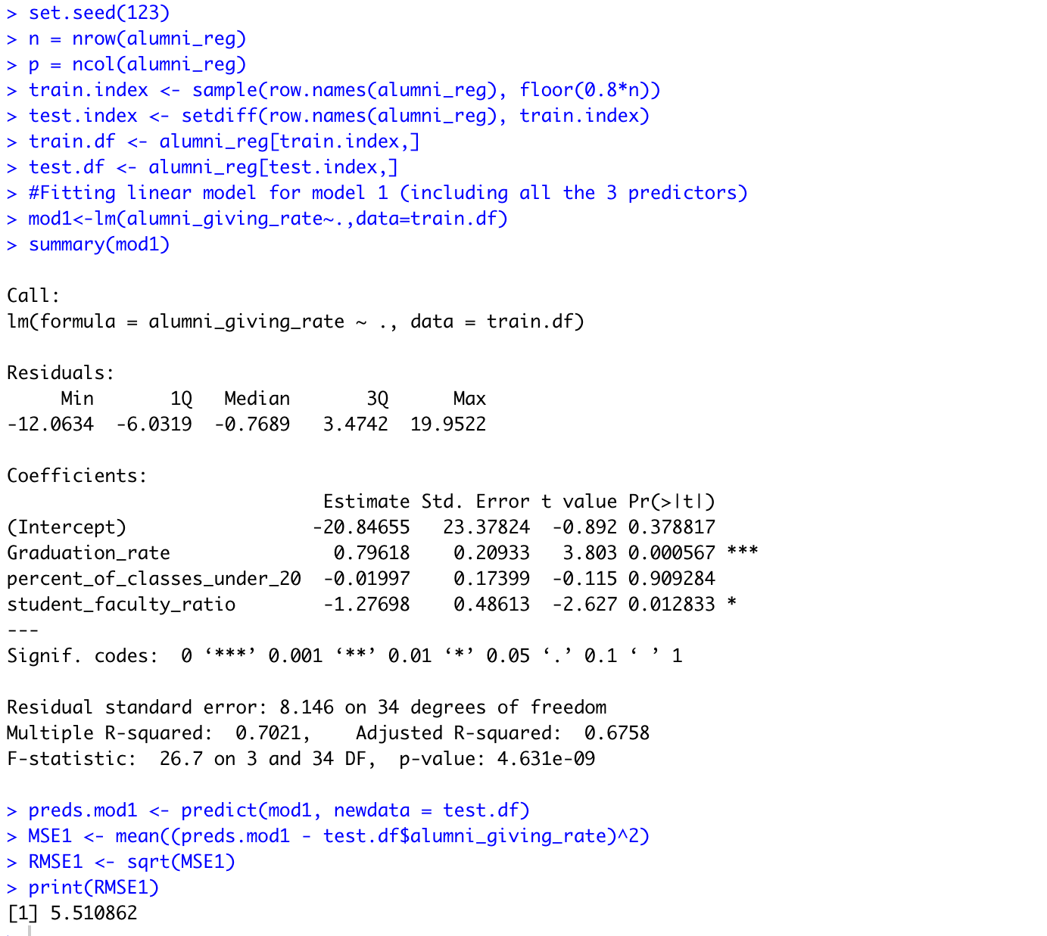
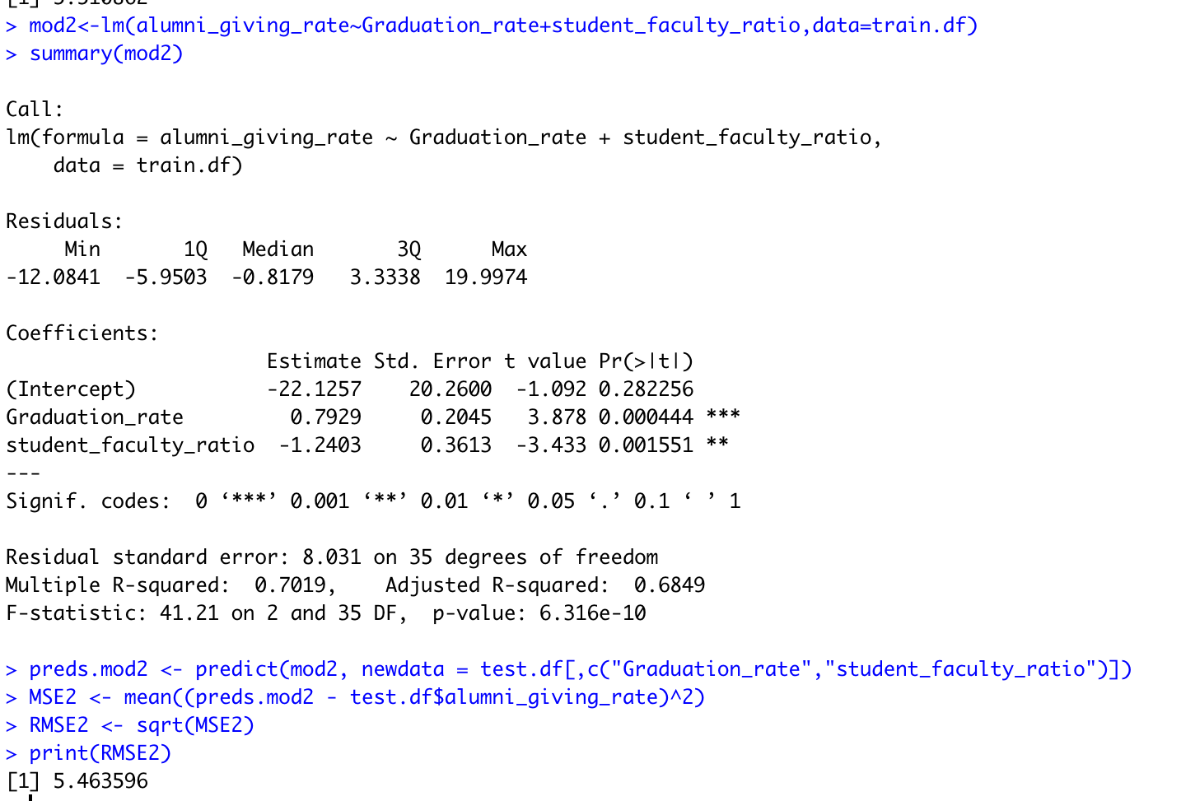
Model 1 and Model 2

Slide 13
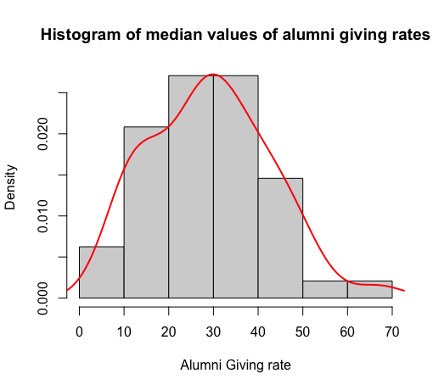
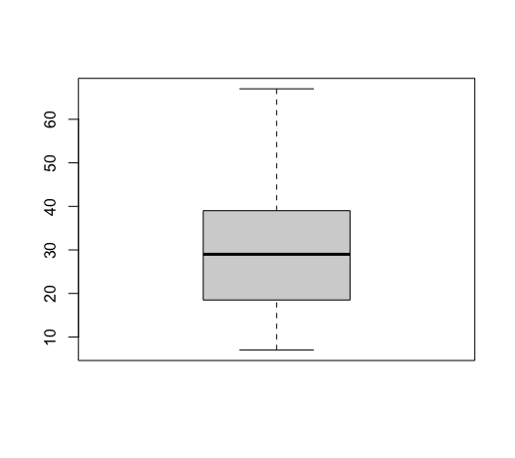
Exploratory Data Analysis
Alumni giving rate

Slide 14
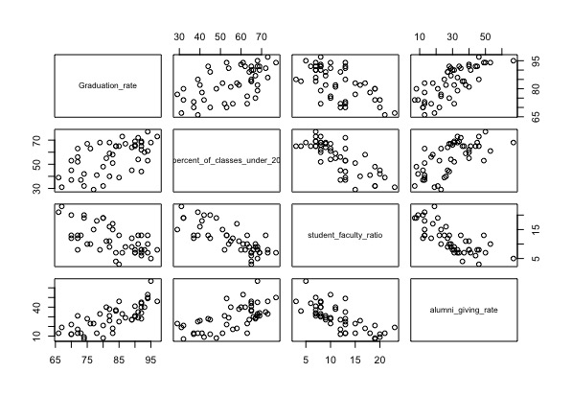
EDA (Continued)
Side by side plot

Slide 15
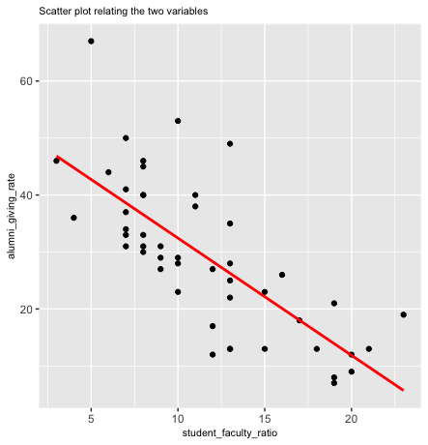
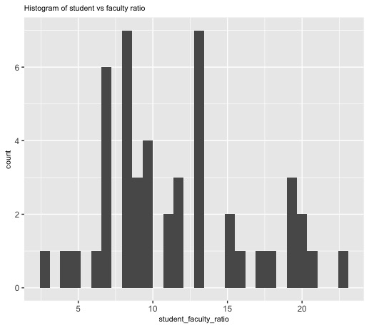
EDA (Continued)
Distribution between alumni giving rate and student faculty ratio

Slide 16
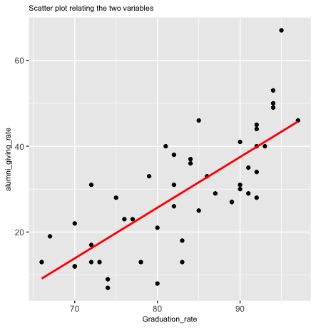
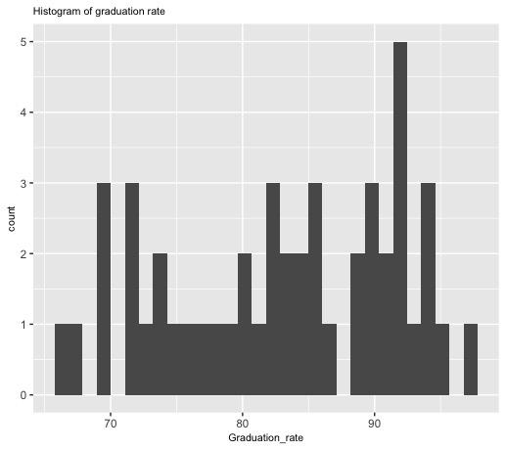
EDA (Continued)
Distribution between alumni giving rate and graduation rate

Slide 17
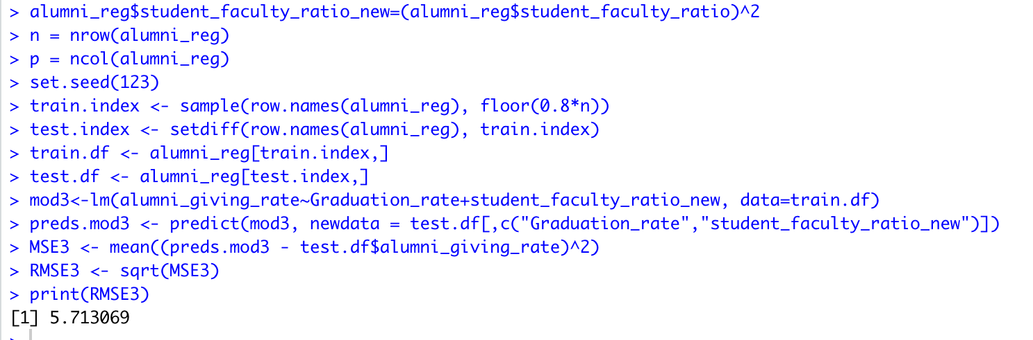
Comparing further Models : Model 3
EDA inference result : Applying squared transformation on student-faculty ratio.
Root mean squared value increased
Not a better model

Slide 18
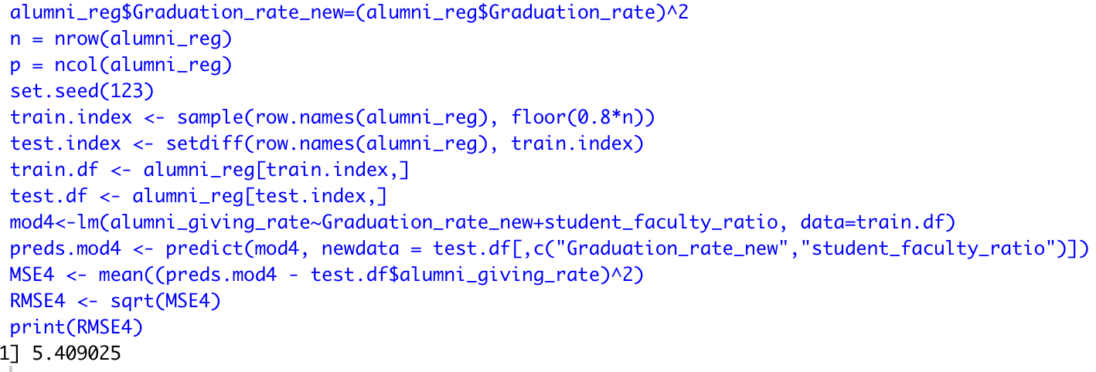
Comparing Further Models : Model 4
Applying squared transformation on graduation rate
Root mean squared value decreased
Prediction increased by 15 percent
Better model

Slide 19
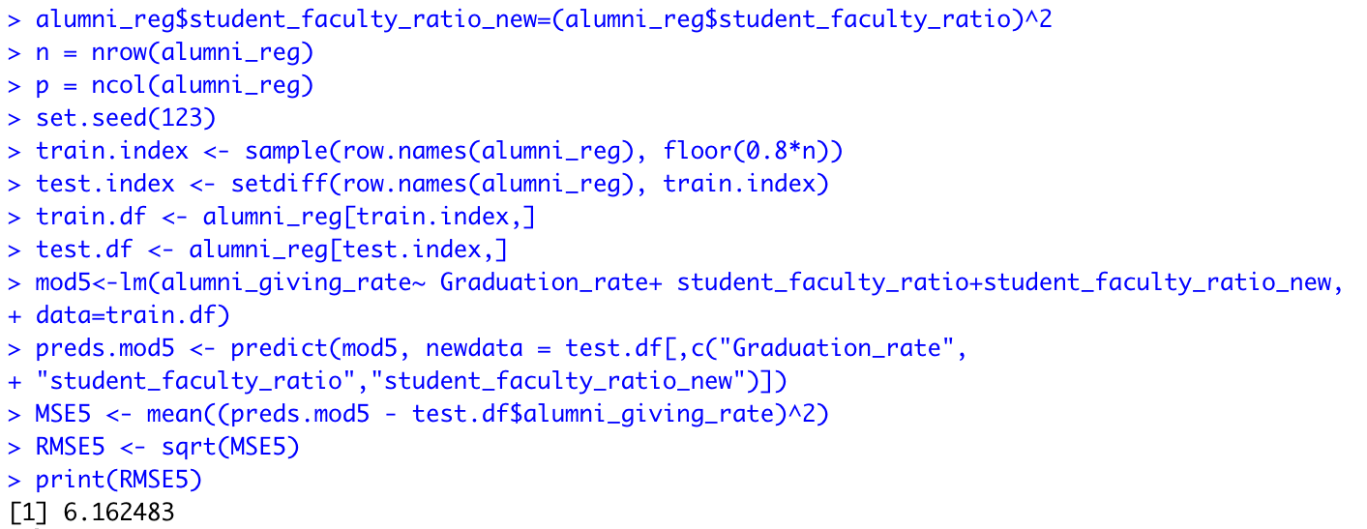
Comparing Further Models : Model 5
To further increase prediction accuracy: Applying quadratic transformation on student-faculty ratio
RMSE value further increased

Slide 20
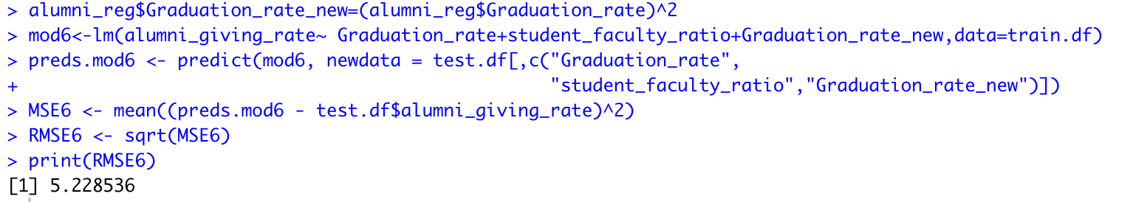
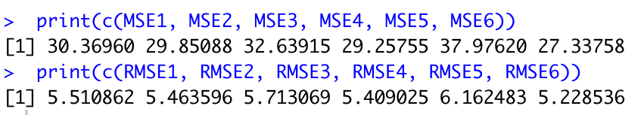
Final Model : Model 6
To further increase prediction accuracy: Applying quadratic transformation on graduation rate.
The root mean squared value was the least among 6 models.

Slide 21
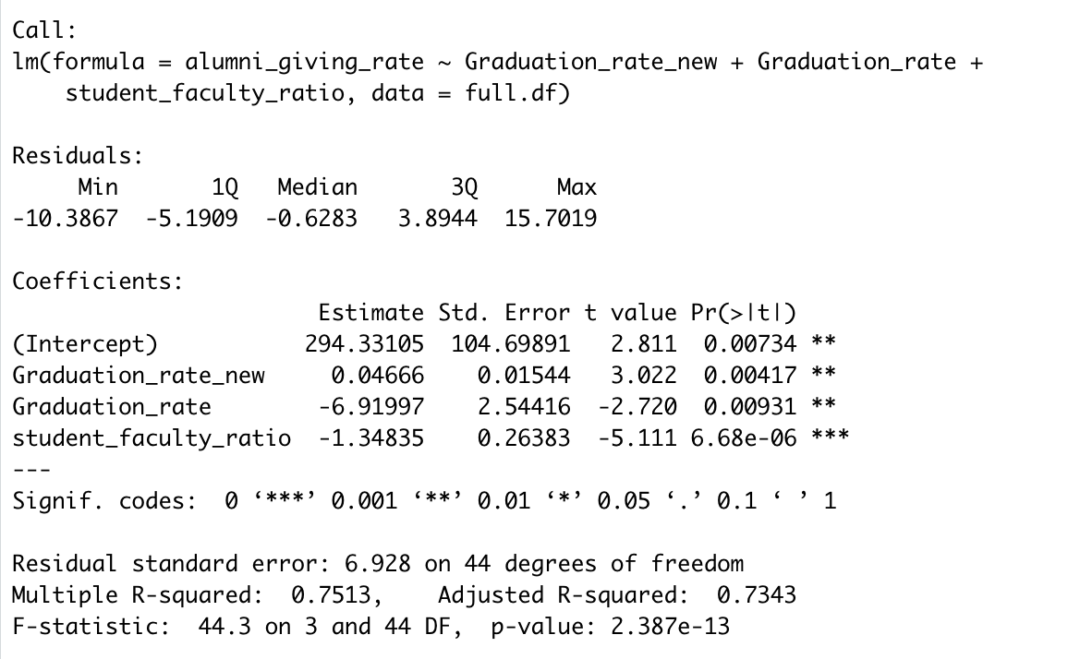
Final Linear Regression Model
alumni_giving_rate = 294.331 + 0.047* Graduation_rate^2 – 6.92 * Graduation_rate - 1.348 * student_faculty_ratio

Slide 22
Prediction Result
University | State | Graduation Rate | % of Classes Under 20 | Student-Faculty Ratio | Alumni Giving Rate | Model6 | Percentage difference
Boston College | MA | 85 | 39 | 13 | 25 | 25.72355 | 3%
Massachusetts Inst. of Technology | MA | 92 | 65 | 6 | 44 | 44.53395 | 1%
Rice University | TX | 92 | 62 | 8 | 40 | 41.83725 | 5%
U. of California–Berkeley | CA | 83 | 58 | 17 | 18 | 18.49233 | 3%
U. of California–Santa Barbara | CA | 70 | 45 | 20 | 12 | 11.60015 | -3%
U. of Chicago | IL | 84 | 65 | 4 | 36 | 36.89313 | 2%
U. of Pennsylvania | PA | 90 | 65 | 7 | 41 | 40.0413 | -2%
U. of Rochester | NY | 76 | 63 | 10 | 23 | 24.43799 | 6%
U. of Southern California | CA | 70 | 53 | 13 | 22 | 21.0386 | -4%
U. of Texas–Austin | TX | 66 | 39 | 21 | 13 | 12.54864 | -3%

Slide 23
Conclusion & Recommendation
The alumni giving rate can be maximized by
Reducing student-faculty ratio
Increased graduation rate in most cases
Possible recommendation
Hire more staff
Increasing university facilities and resources

Slide 24


